Slide 1
Predicting the thermodynamic effect of mutations on a genome-wide scale
Alexey Strokach

Slide 2
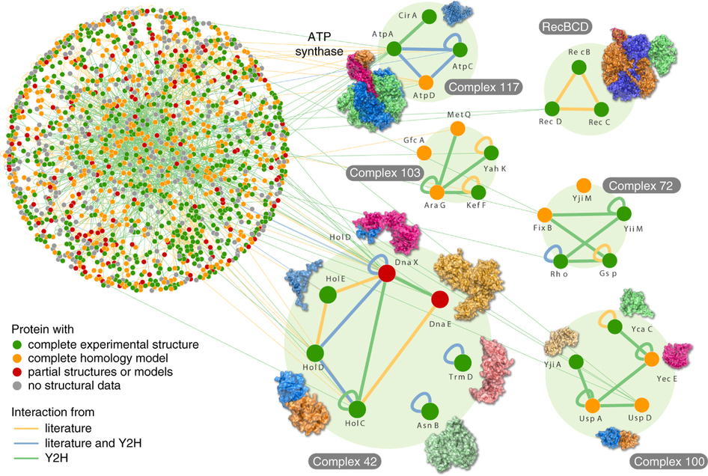
Overview
Goal: Predict the effect of mutations on protein stability and protein interaction affinity on a genome-wide scale.
Rajagopala S. et al., Nature Biotech., 2014
Profs
Accurate domain definitions for all proteins in a given organism.
Structural templates for domains and domain-domain interactions.
ELASPIC
Homology models of domains and domain interactions.
A classifier trained to predict the effect of mutations on protein stability and protein interaction affinity.

Slide 3
Overview

Slide 4
Overview
Introduction
Implementation
ELASPIC database
Homology modelling of the human proteome
ELASPIC pipeline
ELASPIC REST API
Results
Grid-search (to find a good set of parameters)
Feature elimination
Discussion
What have we learned?
Future directions

Slide 5
Introduction

Slide 6
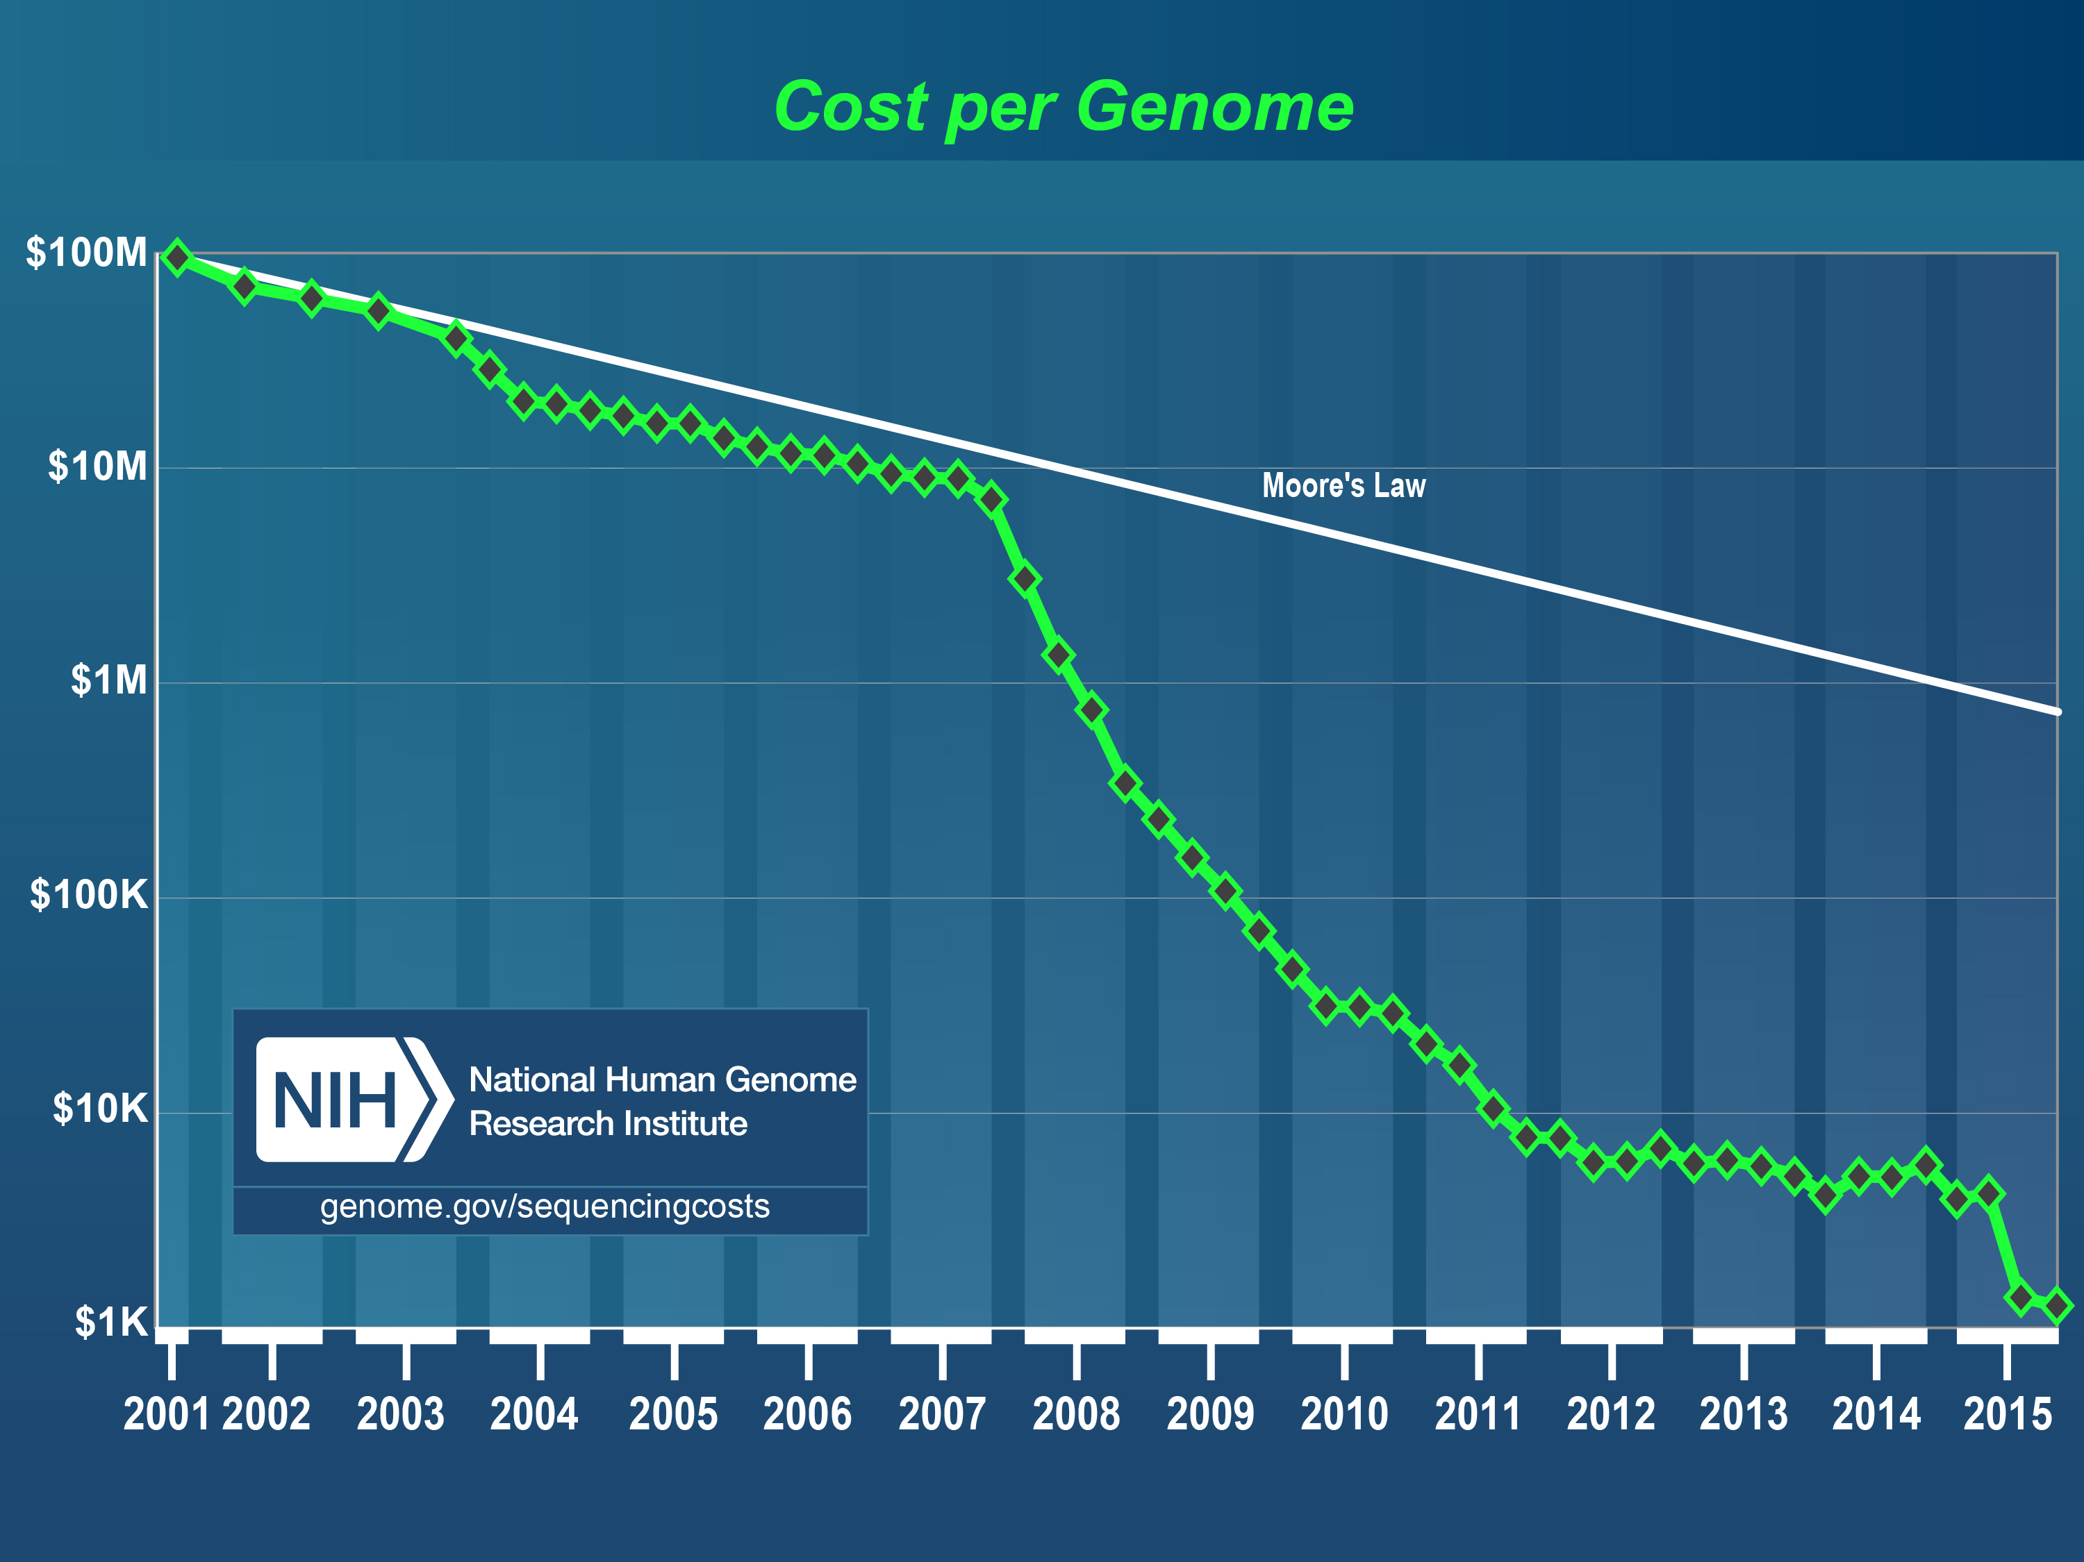
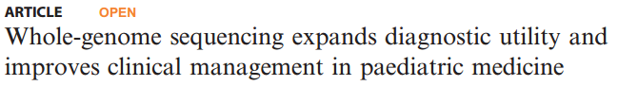
Introduction - Rise in genome sequening
Cost of genome sequencing has fallen dramatically.
Interpreting genomic variants to yield meaningful and actionable results remains a challenge.
https://www.genome.gov/27541954/dna-sequencing-costs-data/

Slide 7
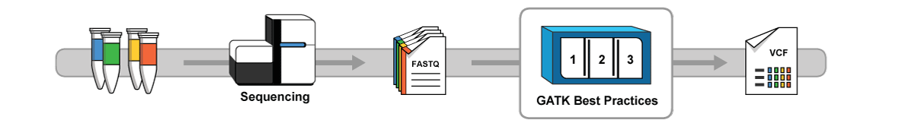
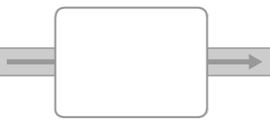






Introduction - Variant calling / scoring
Variant calling
https://software.broadinstitute.org/gatk/
Variant scoring
# chr position ref alt...
SIFT
Provean
GERP++
etc...
dbNSFP

Slide 8
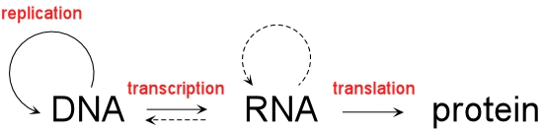

Introduction - Variant analysis
Rajagopala S. et al., Nature Biotech., 2014.

Slide 9
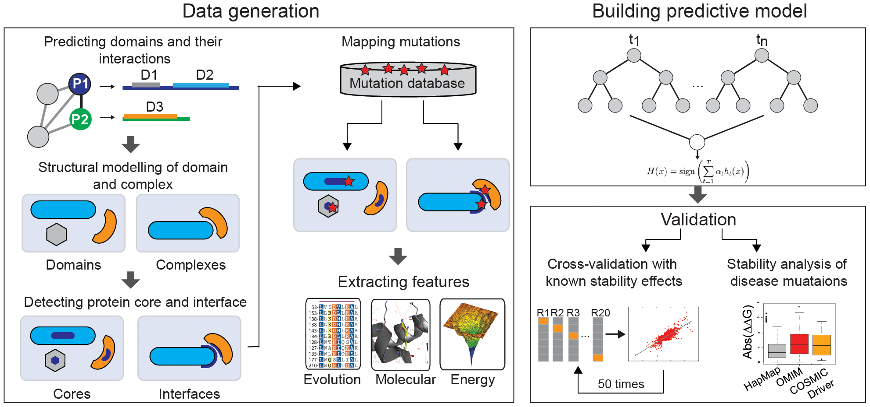
Introduction - Variant analysis
ELASPIC v2014
Niklas Berliner et al. PPLoS ONE 9(9): e107353. (2014)

Slide 10
Introduction - Goals
Goals
- Improvenets
Profs for domain definitions
Provean instead of SIFTS so that we can run in consistently.
Expand ELASPIC to work on a genome-wide scape
- Provean instead of SIFT
- ...
- ...

Slide 11
Implementation
Evaluating the impact of mutations on protein stability and protein-protein affinity.

Slide 12
Implementation

Slide 13
Implementation - Database

Slide 14
Implementation - Pipeline

Slide 15
Implementation - Webservice

Slide 16
Results

Slide 17
Results - Homology modelling coverage

Slide 18
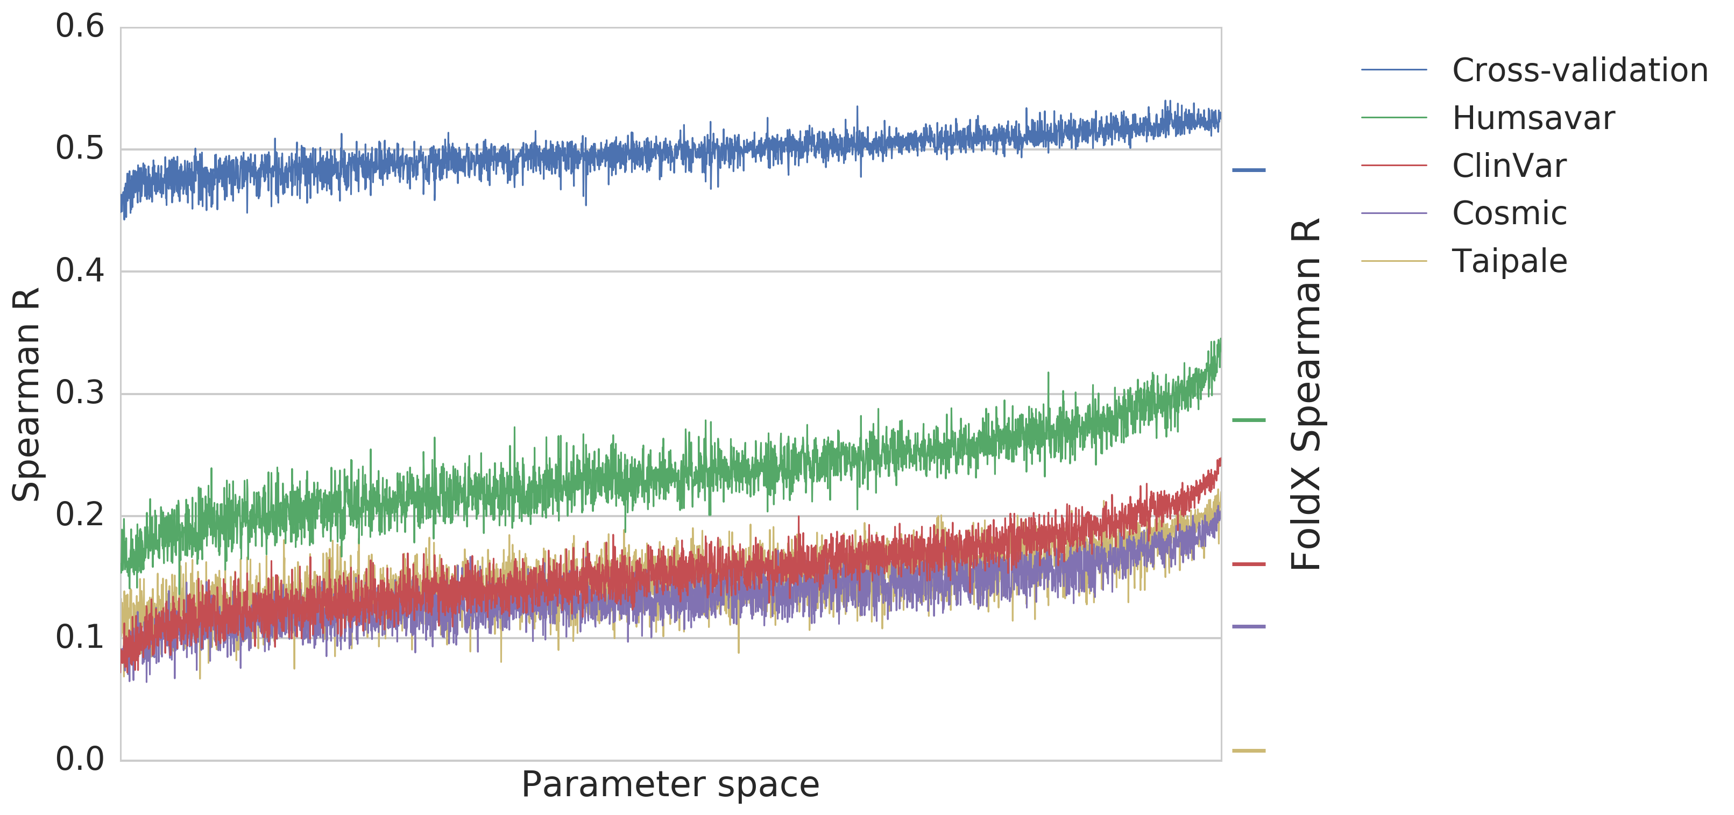
Results - Core training

Slide 19
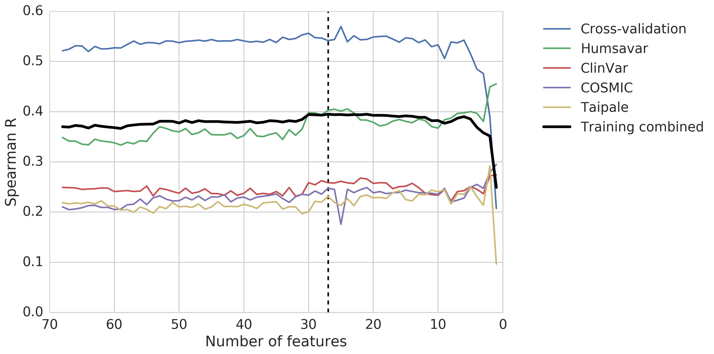
Results - Core feature elimination

Slide 20
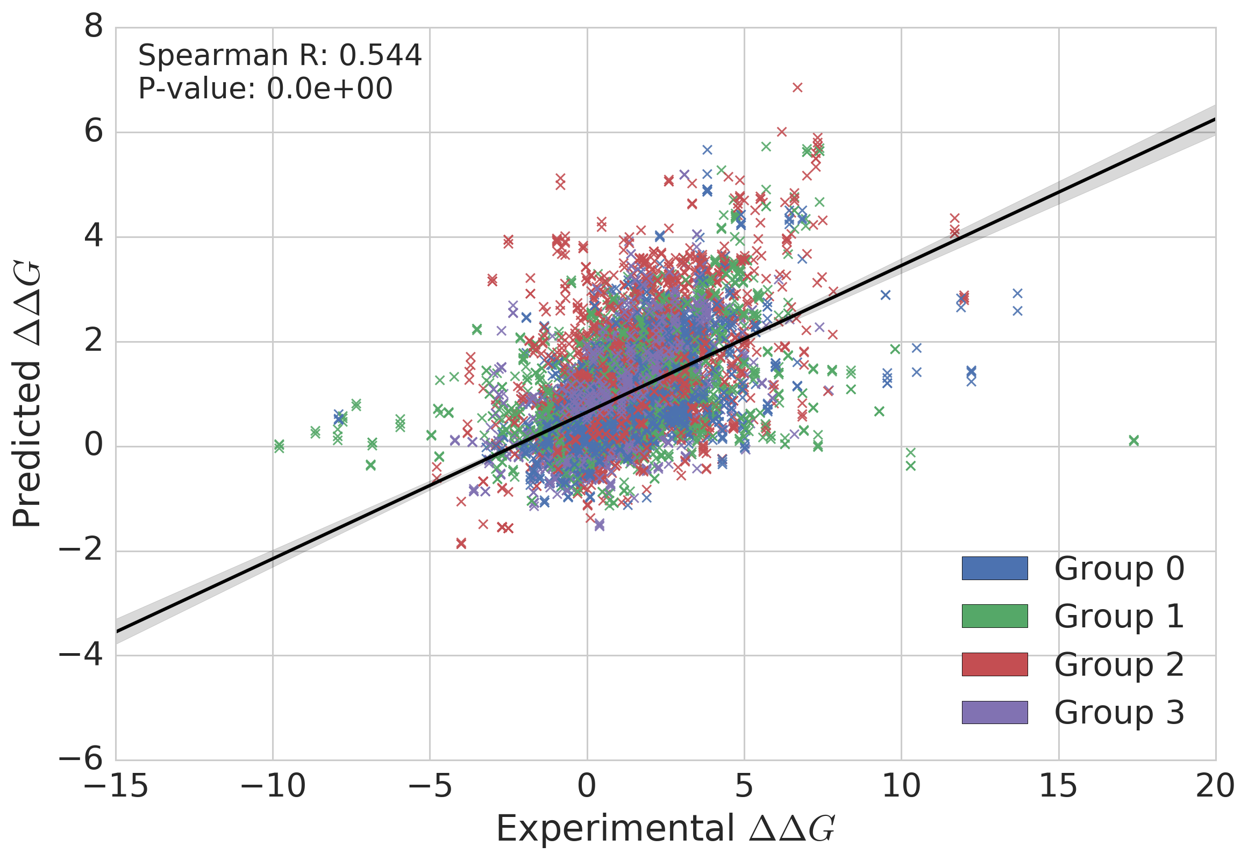
Results - Core validation

Slide 21
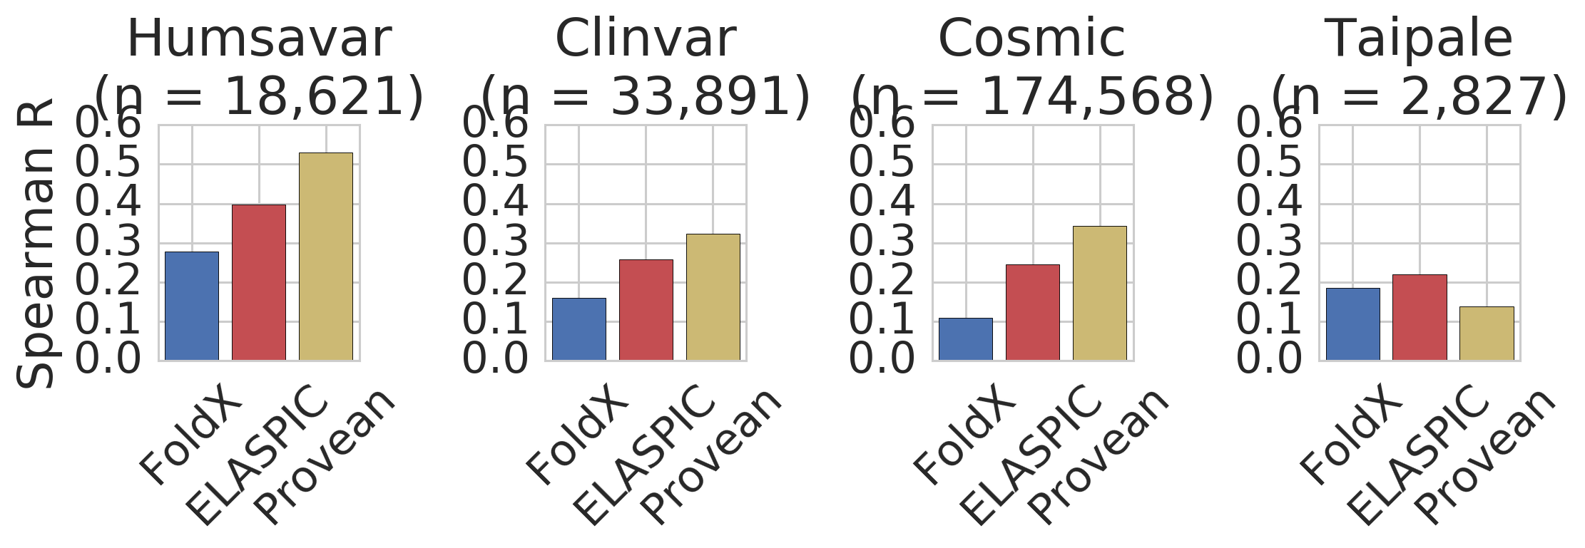
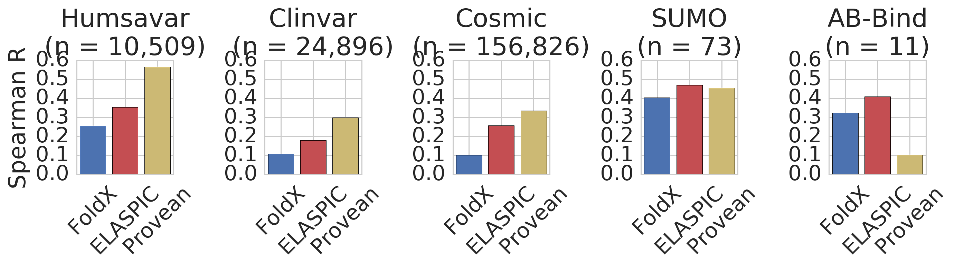
Results - Core validation

Slide 23
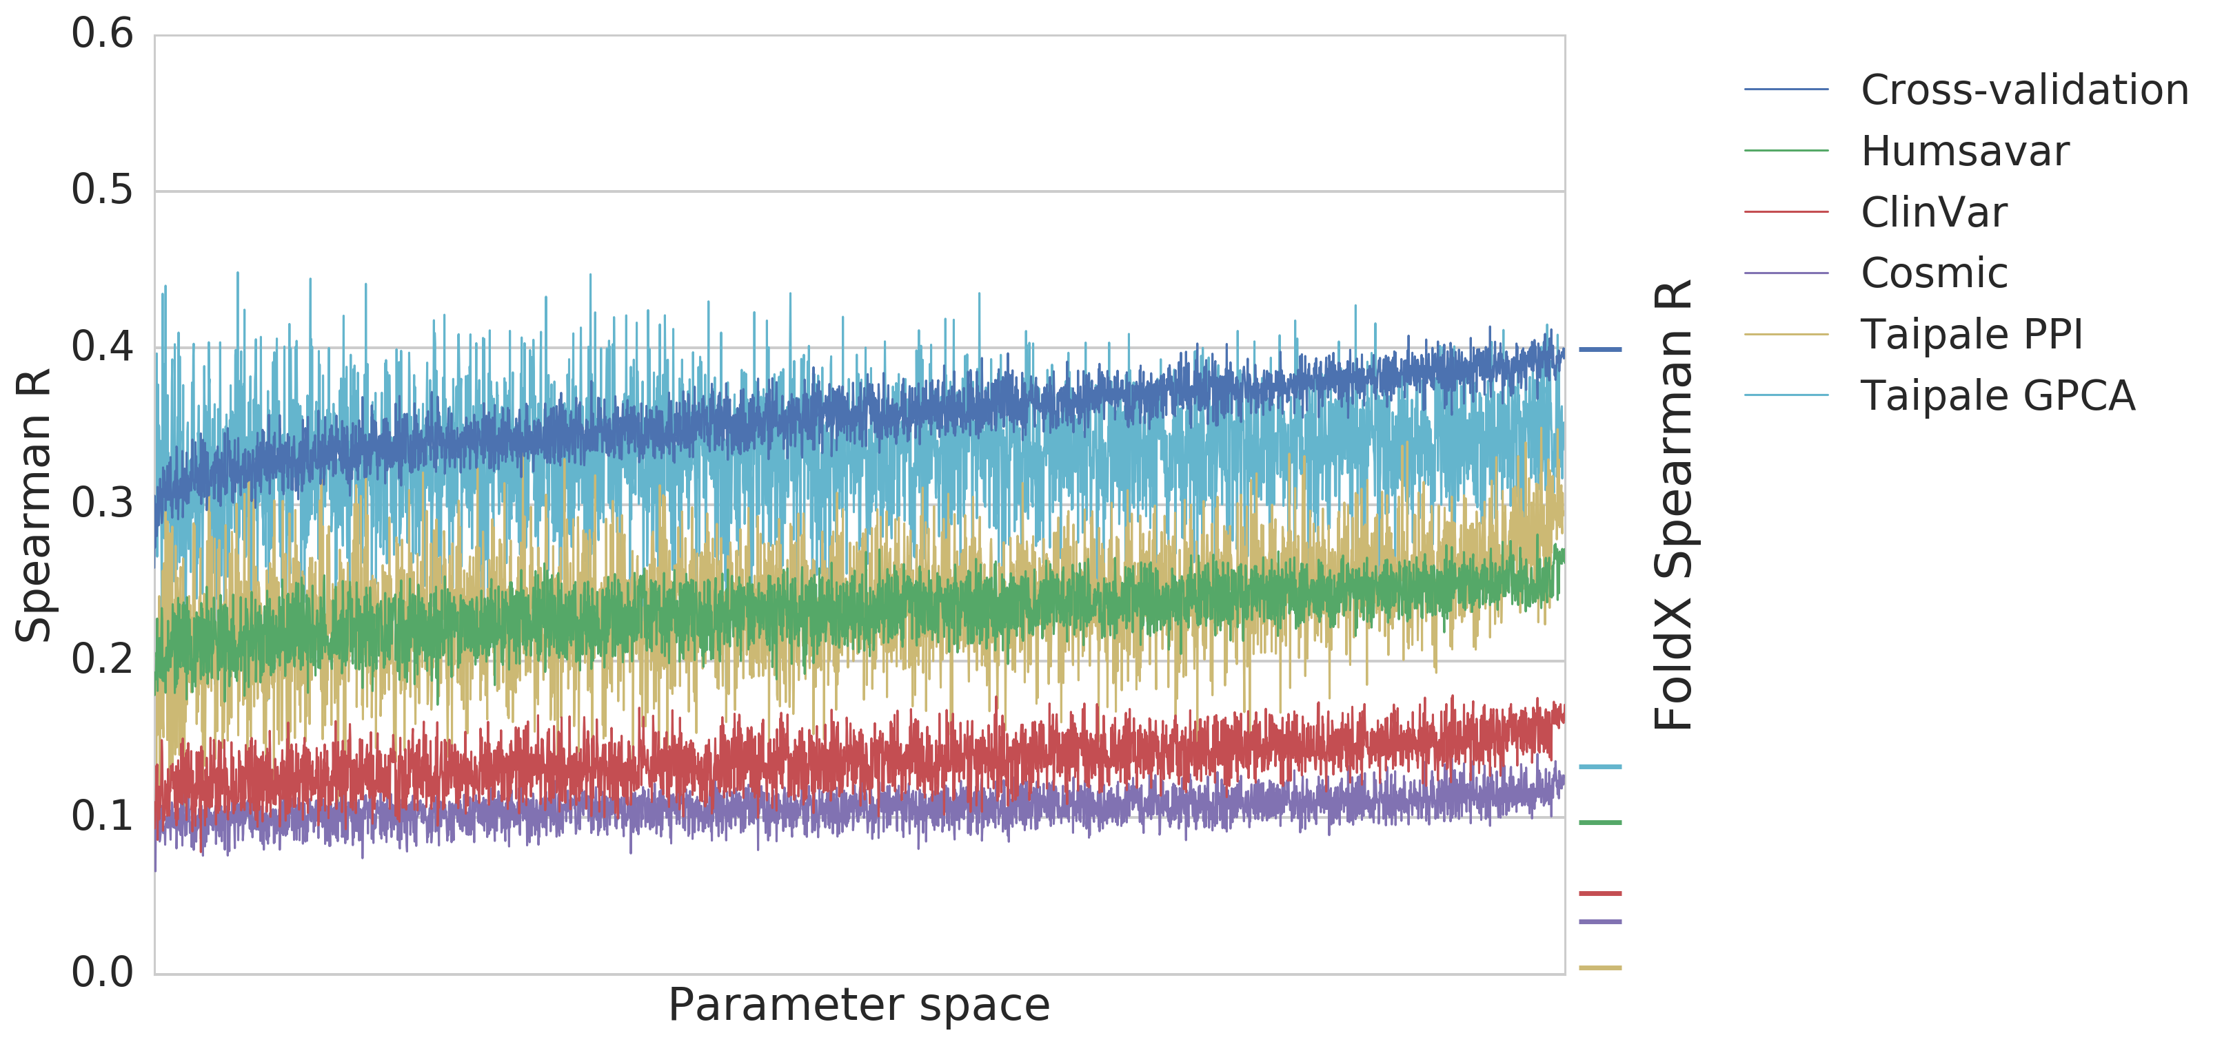
Results - Interface predictor training

Slide 24
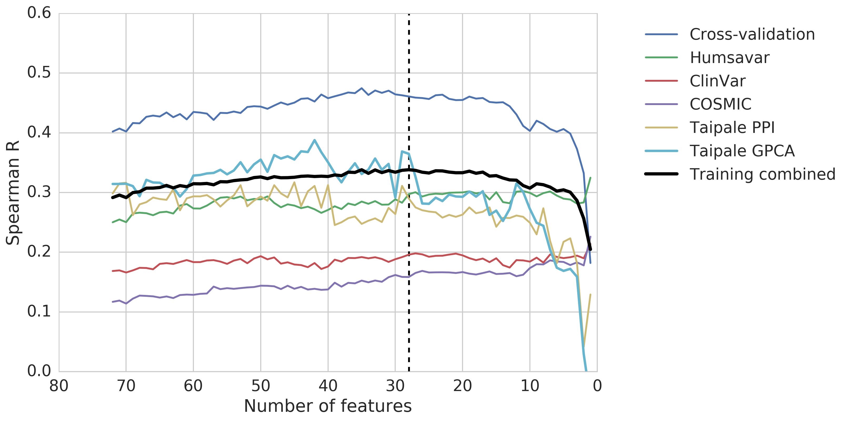
Results - Interface predictor feature eliminatio

Slide 25
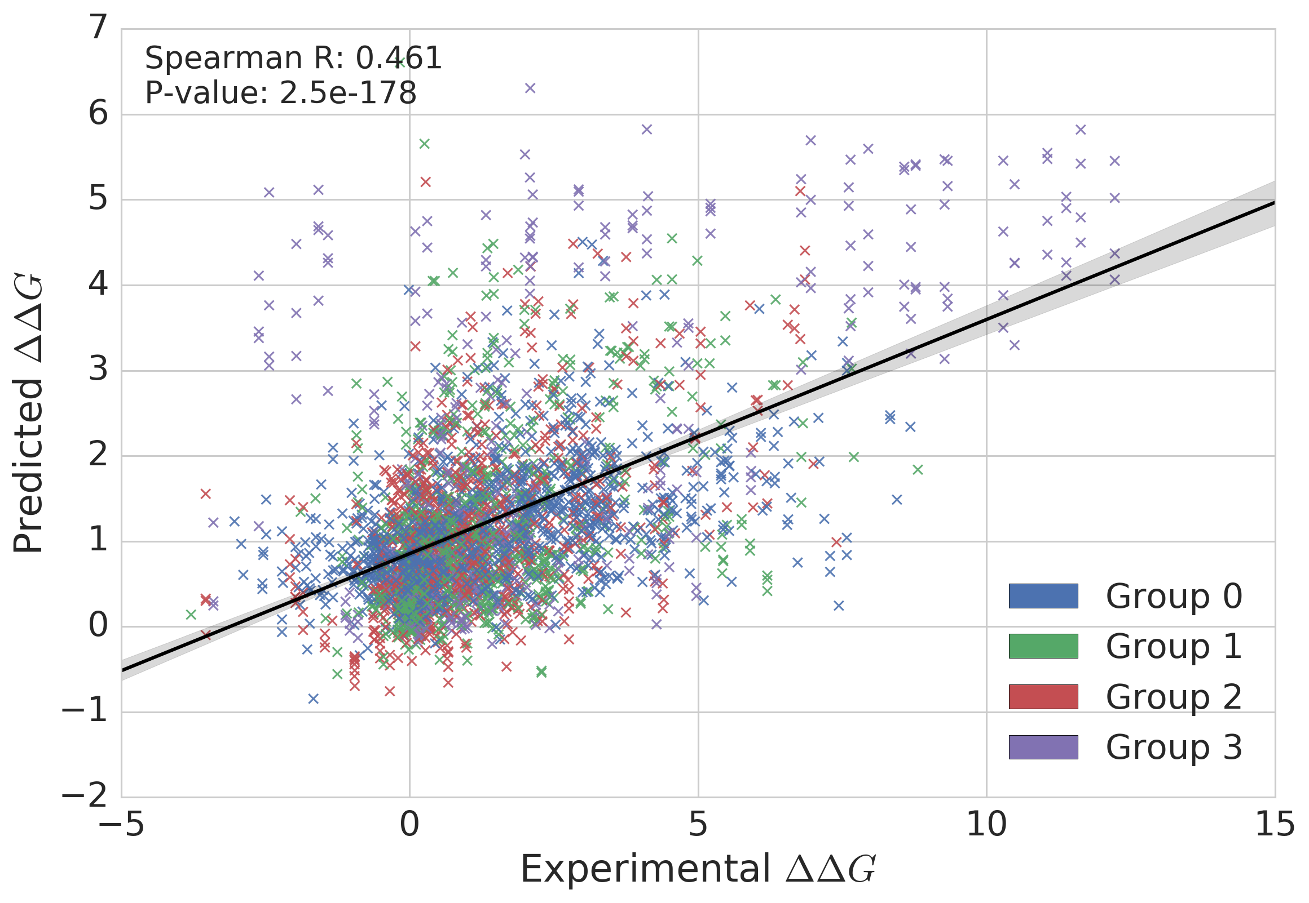
Results - Interface validation

Slide 26
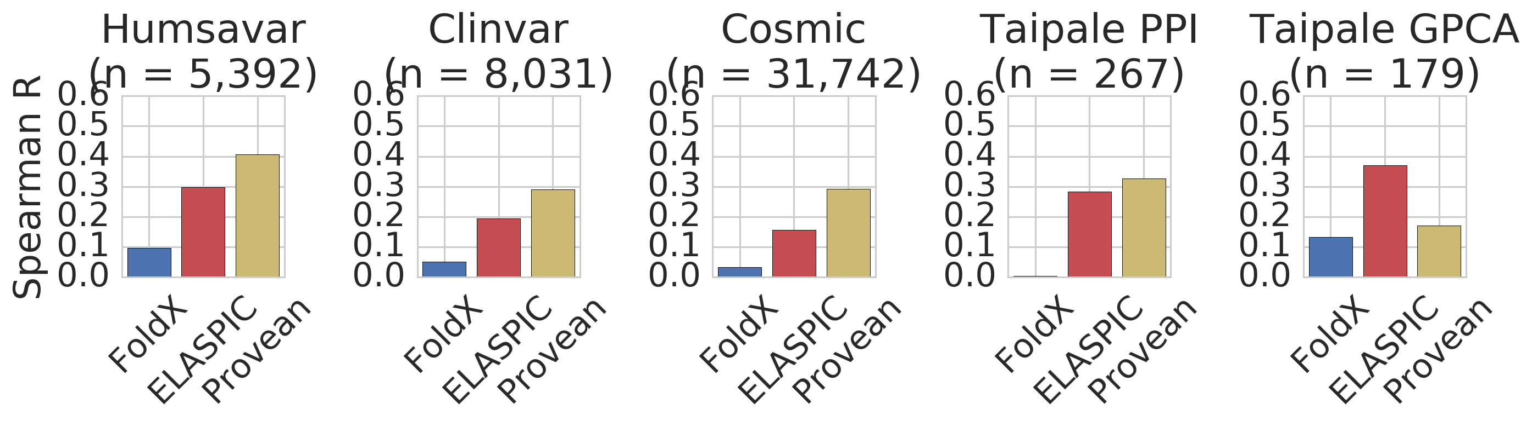
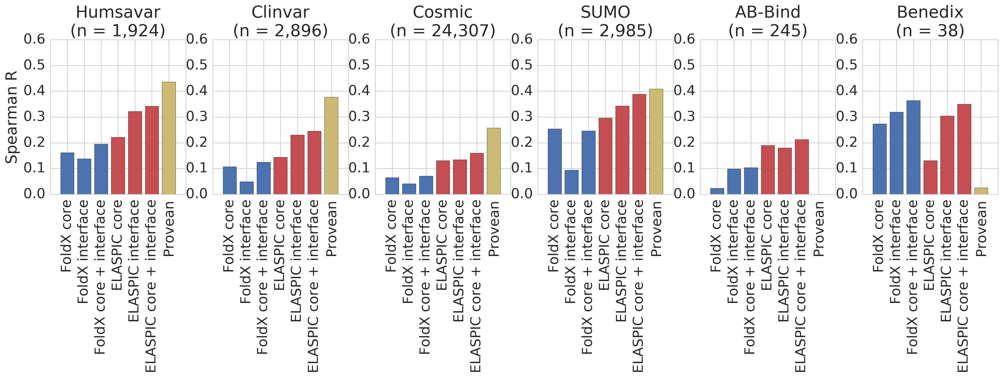
Results - Interface validation

Slide 27
Results - Interface validation performance

Slide 28
Future directions

Slide 29
Future directions - Better models
Lessons from convolutional neural networks:
Pretrain a deep ConvNet on a large dataset (e.g. ImageNet)
Use the first layer(s) in other applications with a smaller training set

Slide 30
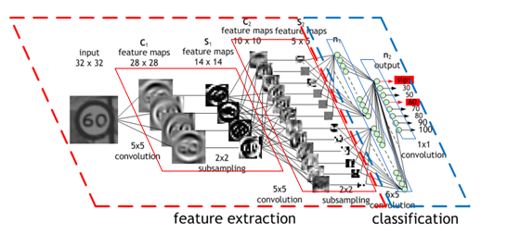
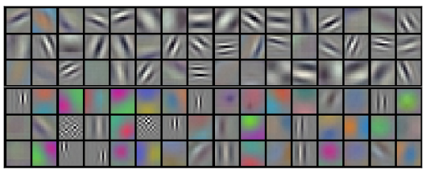
Future directions - Better models

Slide 31
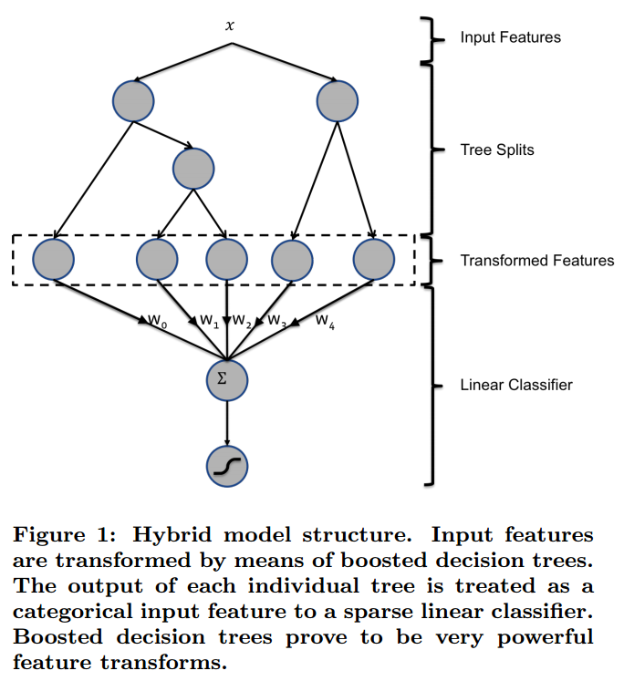
Future directions - Better models
Train to predict the deleteriousness of mutations.
Train to predict ∆∆G.

Slide 32
Future directions - Better models
Use the same approach for ELASPIC:
Feature extraction using a Gradient Boosting Classifier (GBC) trained to predict deleteriousness scores
Logistic regression using trained GBC features as input to predict mutation

Slide 33
Future directions - More data
Include multi-residue mutations
Bootstrap ∆∆G scores of constituent mutations by normalizing the ∆∆G given by ELASIC by the divergence between the ELASPIC predicted and experimental values.

Slide 34
Future directions - Even more data
Include other datasets following the same "bootstrap" procedure.
For the core predictor, create a dataset of mutations to thermophilic organism coming from nearest ancesstor.
For the interface predictor, convert phage-display drop-off scores to ∆∆G and add to ELASPIC training set (maybe need to log-transform or perform other correctionns).

Slide 35
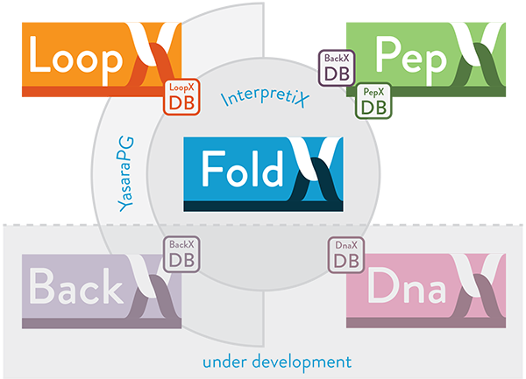
Future directions - ELASPIC v2.0 [v0.2.0 :)]
ELASPIC "napespace" package
core
interface
drug
dna

Slide 36
Future directions - ELASPIC v2.0 [v0.2.0 :)]
ELASPIC "napespace" package
core
interface
drug
dna

Slide 37
Future directions - More interaction types
FoldX

Slide 38
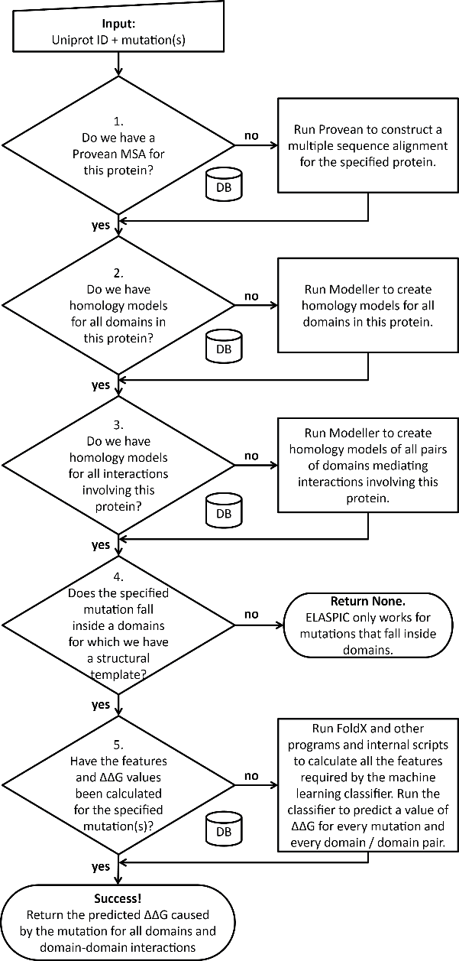

ELASPIC background

Slide 39
ELASPIC background

Slide 40
xxx

Slide 41
ELASPIC background

Slide 42
ELASPIC background

Slide 43
ELASPIC background

Slide 44
ELASPIC background

Slide 45
ELASPIC background

Slide 47
Progress pre-calculating alignments and models
Provean
supporting sets
Uniprot domains
(human)
Uniprot domain pairs
(human)

Slide 48
Progress pre-calculating mutations
Provean
supporting sets
Uniprot domains
(human)
Uniprot domain pairs
(human)

Slide 50
Overview
ELASPIC background and progress
Alanine scanning of PPI interfaces
Correlation with disorderome peptide dropout scores
Validation of ELASPIC results using histone interaction data
Future directions

Slide 51
Results from

Slide 53
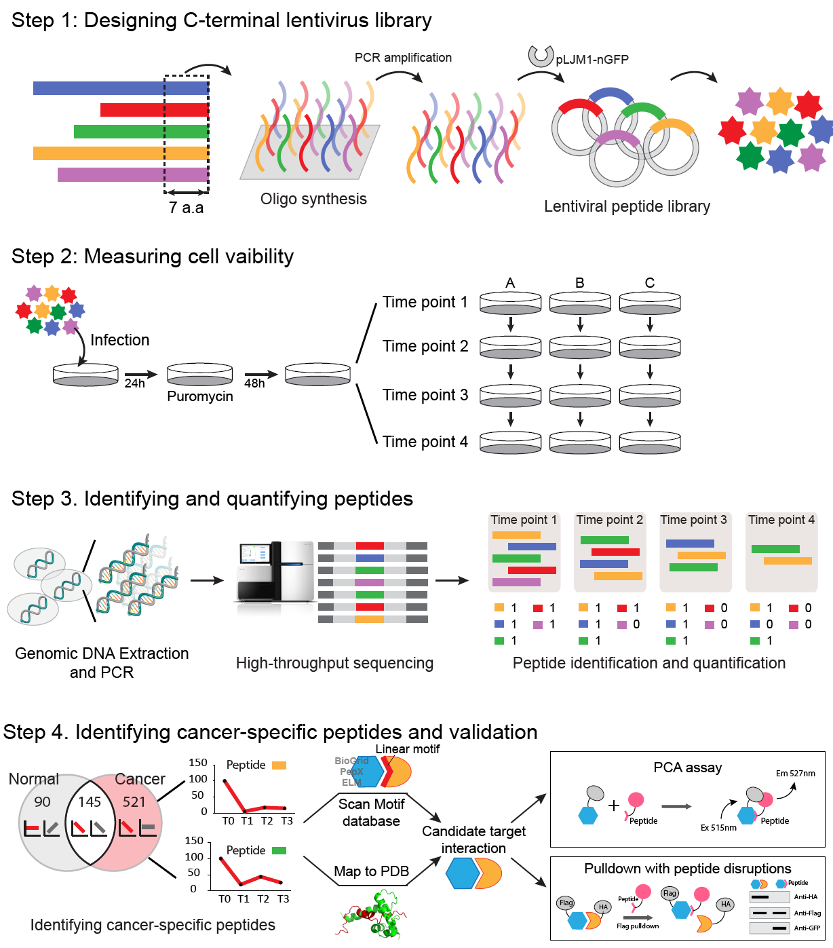
Identifying anti-proliferative peptides
By Satra Nim & Juhyun Clare Jeon

Slide 54

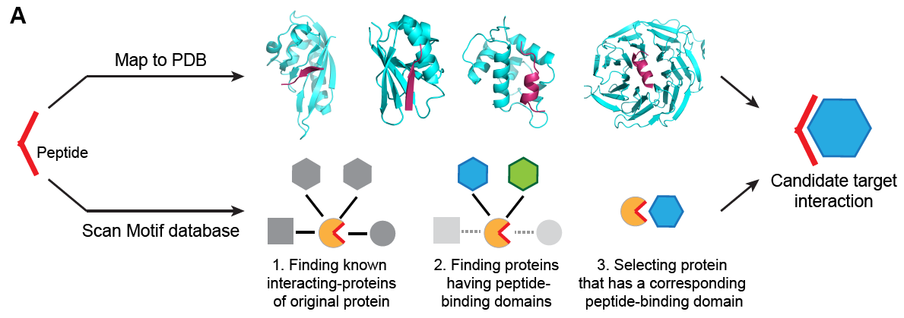

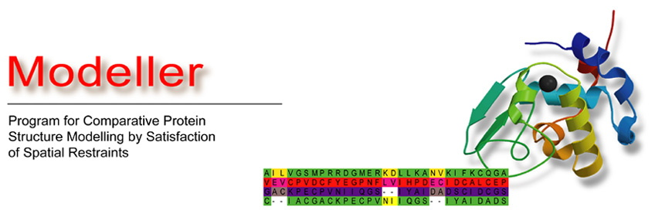
Mapping anti-proliferative peptides to structures
Potential Pairs
Target-Peptide
9,944
Map to DDI
models
+
PSIBLAST
+
HIPPIE
By Carles Corbi

Slide 55
Examples of models with disorderome peptides

Slide 56
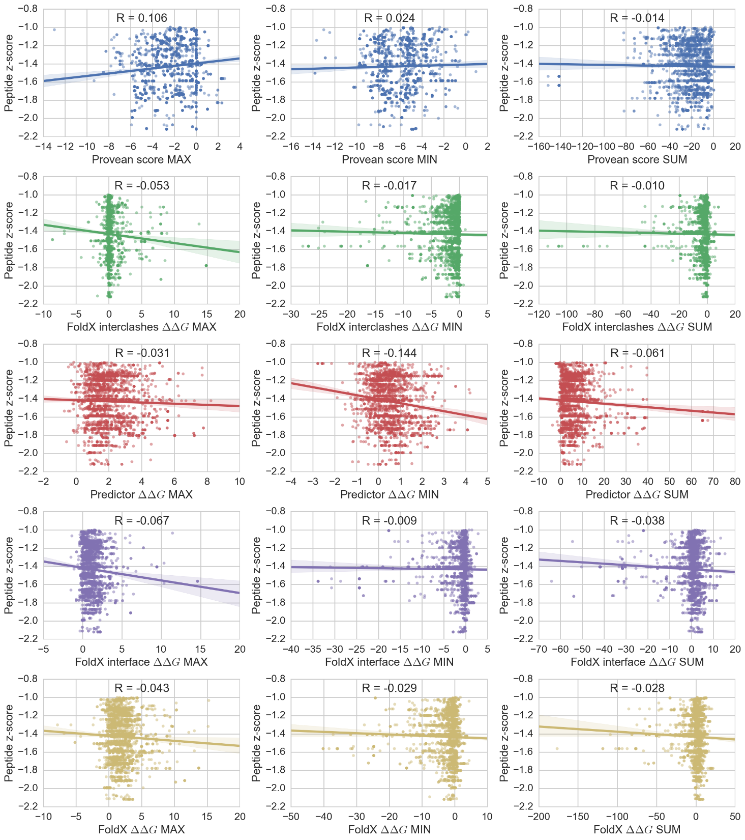
Correlation between features and dropout z-score

Slide 57

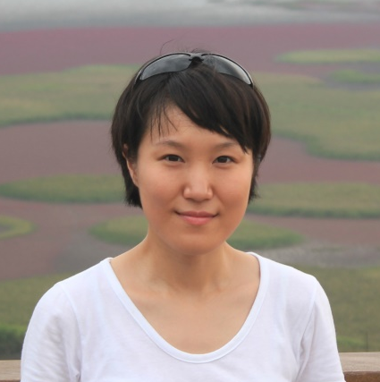
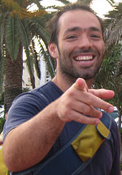
Acknowledgements
Supervisor:
Philip M. Kim
Members of kimlab:
Recep Colak
Carles Corbi
Michael Garton
Clare Juhyun Jeon
Mark Sun
Joan Teyra
Project students:
Niklas Berliner
Andres Felipe Giraldo Forero
Hanif Jetha
Sebastian Garcia Lopez
Daniel Witvliet
Clare Juhyun Jeon
Joan Teyra

Slide 58
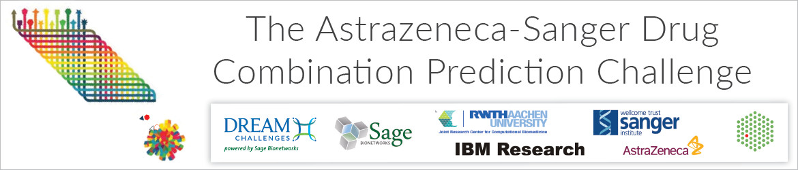
Future directions
~30k experimentally tested drug combinations measuring cell viability over 140 drugs and 120 cancer cell lines (primarily colon, lung, and breast), and monotherapy drug response data for each drug and cell line.
Genomic data including gene expression, somatic mutation, copy-number alterations, and methylation data.

Slide 59
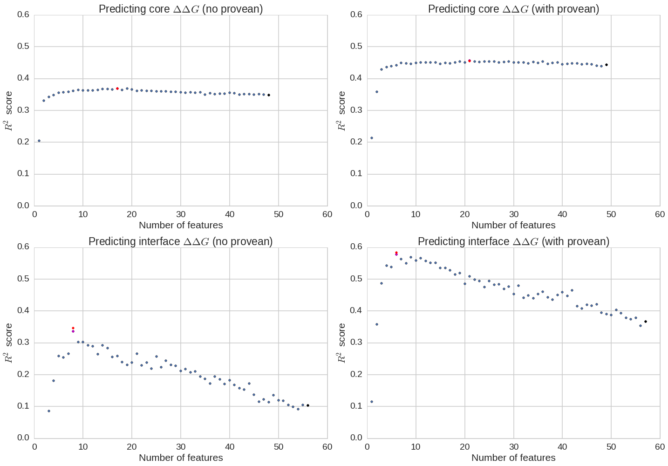
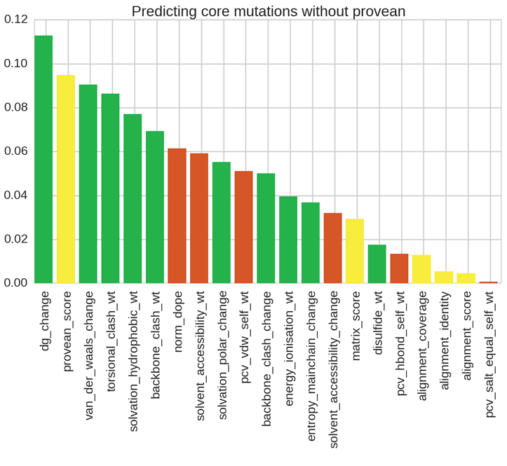
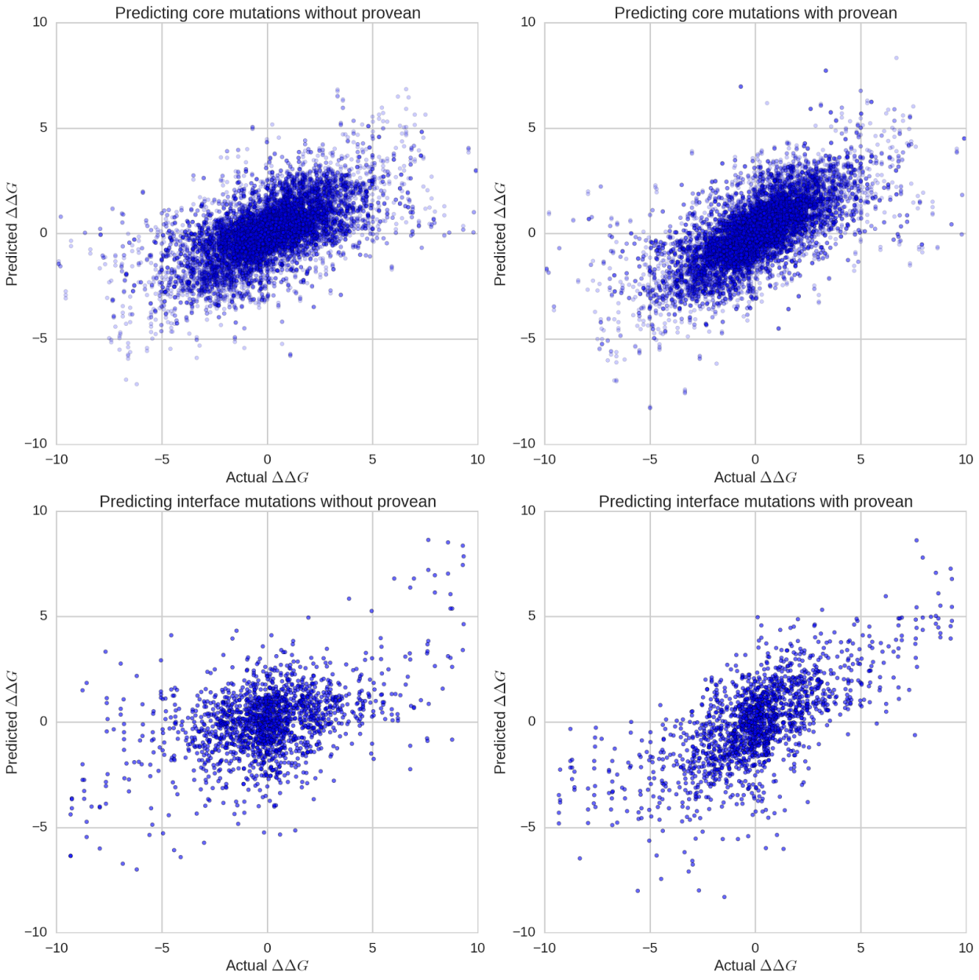
Predicting the effect of CORE mutations
R² = 0.46

Slide 60
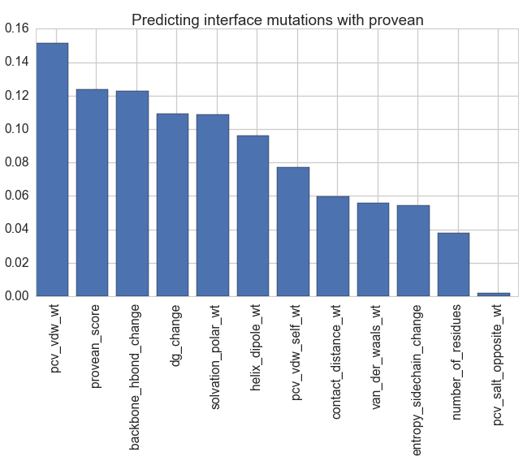
Predicting the effect of INTERFACE mutations
R² = 0.55

Slide 61
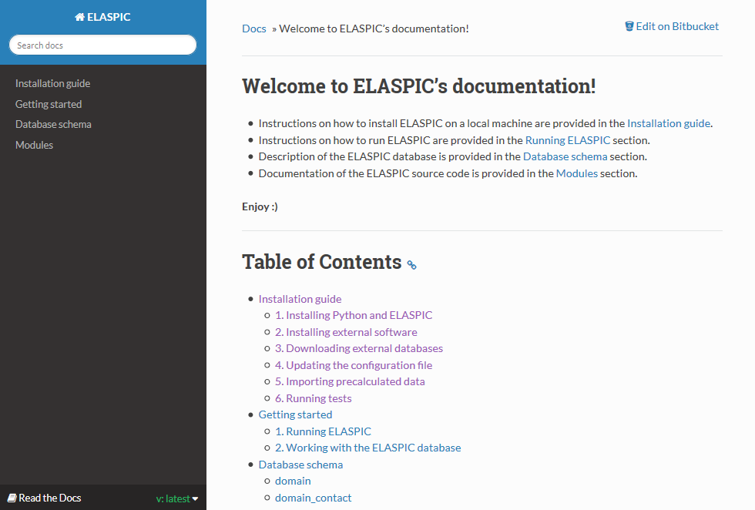
ELASPIC documentation

Slide 62
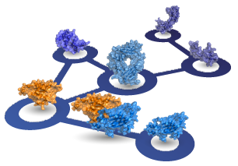
Predicting the thermodynamic effect of mutations
Correct domain boundaries:
PDBFam
ELASPIC pipeline
For every domain in every Uniprot:
Find a structural template for every PDBfam domain in Uniprot
Filter the PPI network, keeping interactions for which a domain-domain contact structure is available
Create homology models for single domains or domain-domain pairs
Compile a list of biophysical and biochemical properties (for each mutation)
Predict the ∆∆G of the mutation
∆G of domain
Mutation ∆∆G of domain folding
PPI network:
Hippie
∆G of protein interaction
Domain structures:
PDB / PDBfam
Mutation ∆∆G of protein interaction
Domain contact structures:
SCOWLP / PDBFam
- Tissue-specific PPI networks (splicing and expression levels)
- Protein function and phenotypic effect of mutations
interactome3d.irbbarcelona.org

Slide 63
Core
Uniprot Domain
Uniprot Domain
Template
Uniprot Domain
Model
Uniprot Domain
Mutation
Uniprot domain id
Uniprot accession
PDBfam name
PDBfam domain definition
Uniprot domain id
- Expanded domain definitions
- Pairwise sequence alignment filename
- Multiple sequence alignment filename
Uniprot domain id
- Model filename
- DOPE score
- dG of folding (FoldX)
Uniprot domain id
- Mutation
- Biophysical properties
- SASA score
- SIFT / PROVEAN score
…
∆∆G score
Profs domain template
Cath id
PDB id
PDB chain
PDB domain definition
PDBfam name
PDBfam clan
Interface (Protein-Protein)
Uniprot Domain Pair
Uniprot Domain
Pair Template
Uniprot Domain
Pair Model
Uniprot Domain
Pair Mutation
Uniprot domain pair id
Uniprot domain id 1
Uniprot domain id 2
Path to data
Type of interaction…
Uniprot domain pair id
- Expanded domain definitions
- Pairwise sequence alignment filenames
Uniprot domain pair id
- Model filename
- DOPE score
- Interface area
- Interacting residue
- dG of interaction (FoldX)
Uniprot domain pair id
- Mutation
- Biophysical properties
- SASA score
- SIFT / PROVEAN score
…
∆∆G score
PDBFam domain contacts
Domain contact id
Cath id 1
PDB contacting residues 1
Cath id 2
PDB contacting residues 2

Slide 64
Core
Uniprot Domain
Uniprot Domain
Template
Uniprot Domain
Model
Uniprot Domain
Mutation
Uniprot domain id
Uniprot accession
PDBfam name
PDBfam domain definition
Uniprot domain id
- Expanded domain definitions
- Pairwise sequence alignment filename
- Multiple sequence alignment filename
Uniprot domain id
- Model filename
- DOPE score
- dG of folding (FoldX)
Uniprot domain id
- Mutation
- Biophysical properties
- SASA score
- SIFT / PROVEAN score
…
∆∆G score
Profs domain template
Cath id
PDB id
PDB chain
PDB domain definition
PDBfam name
PDBfam clan
Interface (Protein-Protein)
Uniprot Domain Pair
Uniprot Domain
Pair Template
Uniprot Domain
Pair Model
Uniprot Domain
Pair Mutation
Uniprot domain pair id
Uniprot domain id 1
Uniprot domain id 2
Path to data
Type of interaction…
Uniprot domain pair id
- Expanded domain definitions
- Pairwise sequence alignment filenames
Uniprot domain pair id
- Model filename
- DOPE score
- Interface area
- Interacting residue
- dG of interaction (FoldX)
Uniprot domain pair id
- Mutation
- Biophysical properties
- SASA score
- SIFT / PROVEAN score
…
∆∆G score
Profs domain contacts
Domain contact id
Cath id 1
PDB contacting residues 1
Cath id 2
PDB contacting residues 2

Slide 65
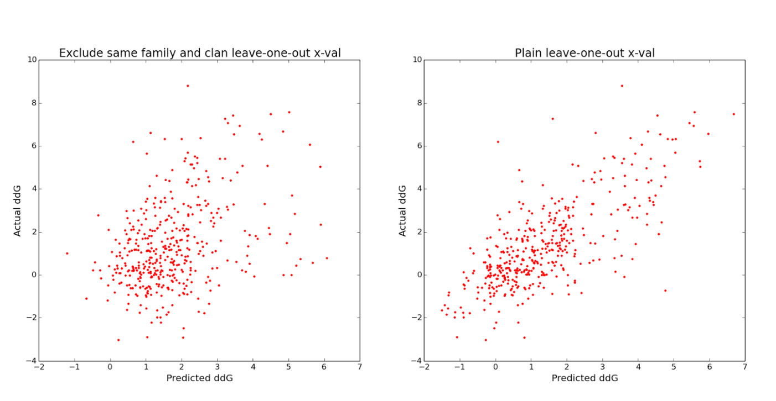

Predicting the ddG of interface mutations
As a training set, we used the Skempi database, which contains ddG values for 862 interface mutations in crystallized protein complexes.
Leave-one-out cross-validation while excluding members of the same pfam family and clan from the training set results in a correlation coefficient of 0.37, mainly because most cross-validation bins have < 100 training points.
Naïve leave-one-out cross-validation results in a correlation coefficient of 0.74 .

Slide 66
Talk Overview
CSC2534 - Decision Making Under Uncertainty
Combining proteins and diseases in a probabilistic graphical network
ELASPIC
Using structural and functional features to predict the phenotypic consequence of mutations

Slide 67
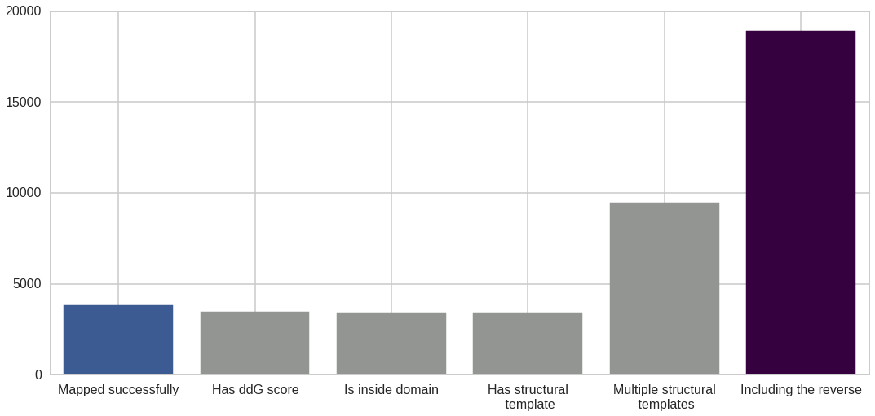
Creating the core and interface training sets
Mapping mutations from Protherm / Skempi and from small-scale studies
Filtering out mutations that don’t fall inside domains
Making homology models of different sequence identities
Reversing the mutation and running the pipeline for mut -> wt
Parsing core mutations

Slide 68
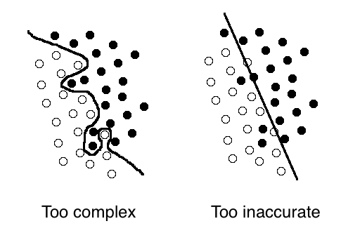
Training the core and interface classifiers
Perform grid-search to find the best hyperparameters using all features
Perform recursive feature elimination to remove features that are not important
Perform grid-search again to find the best hyperparameters when using the final set of features
Train the final classifiers

Slide 69
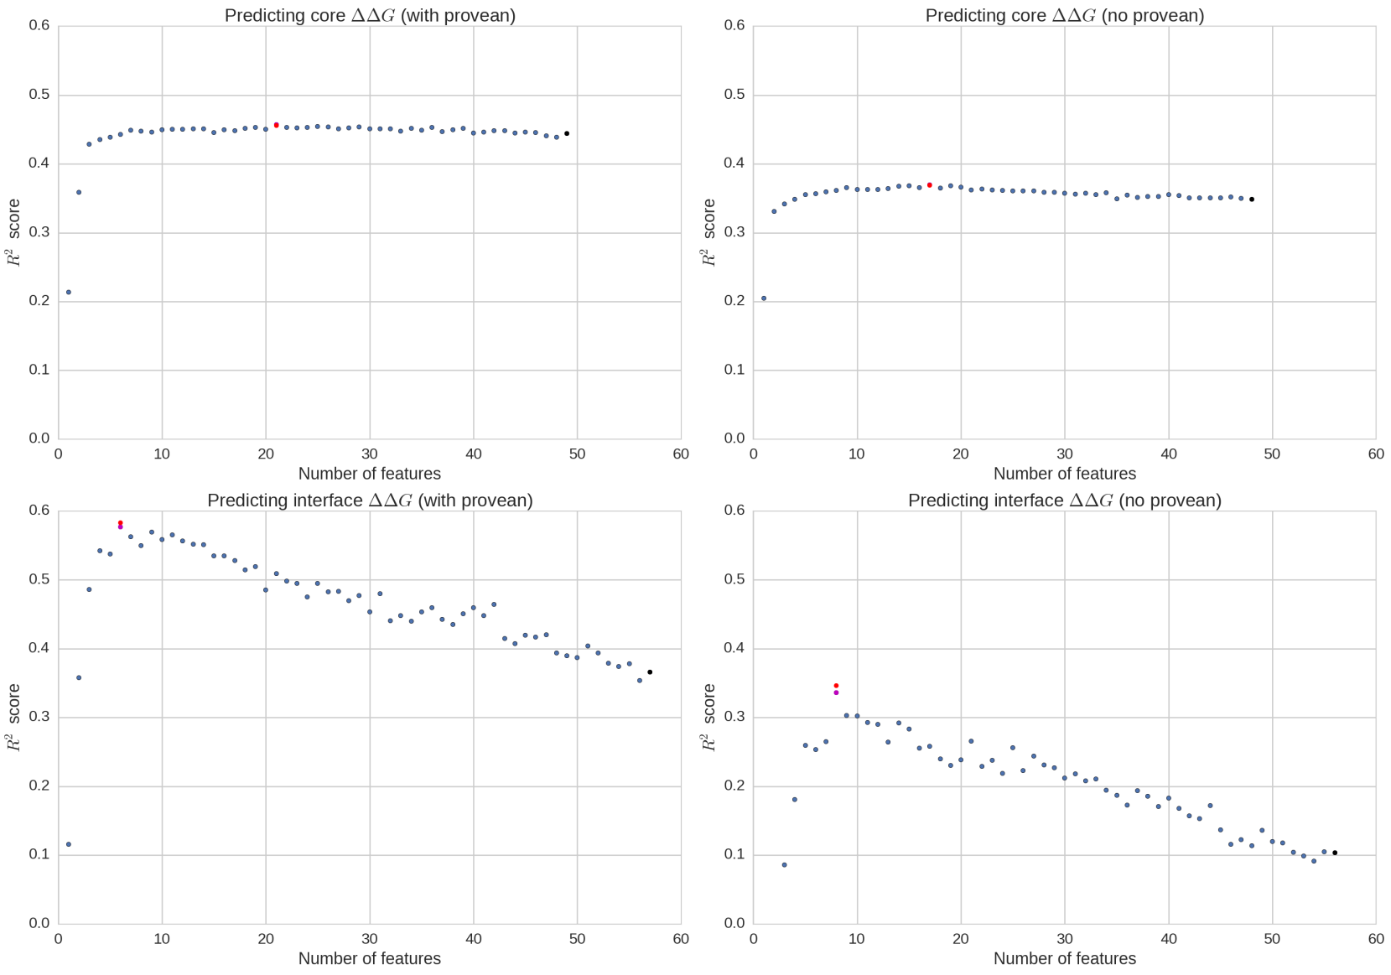
Recursive feature elimination
Provean No reverse mutations
No Provean
Reverse mutations
Core mutations
Interface mutations

Slide 70
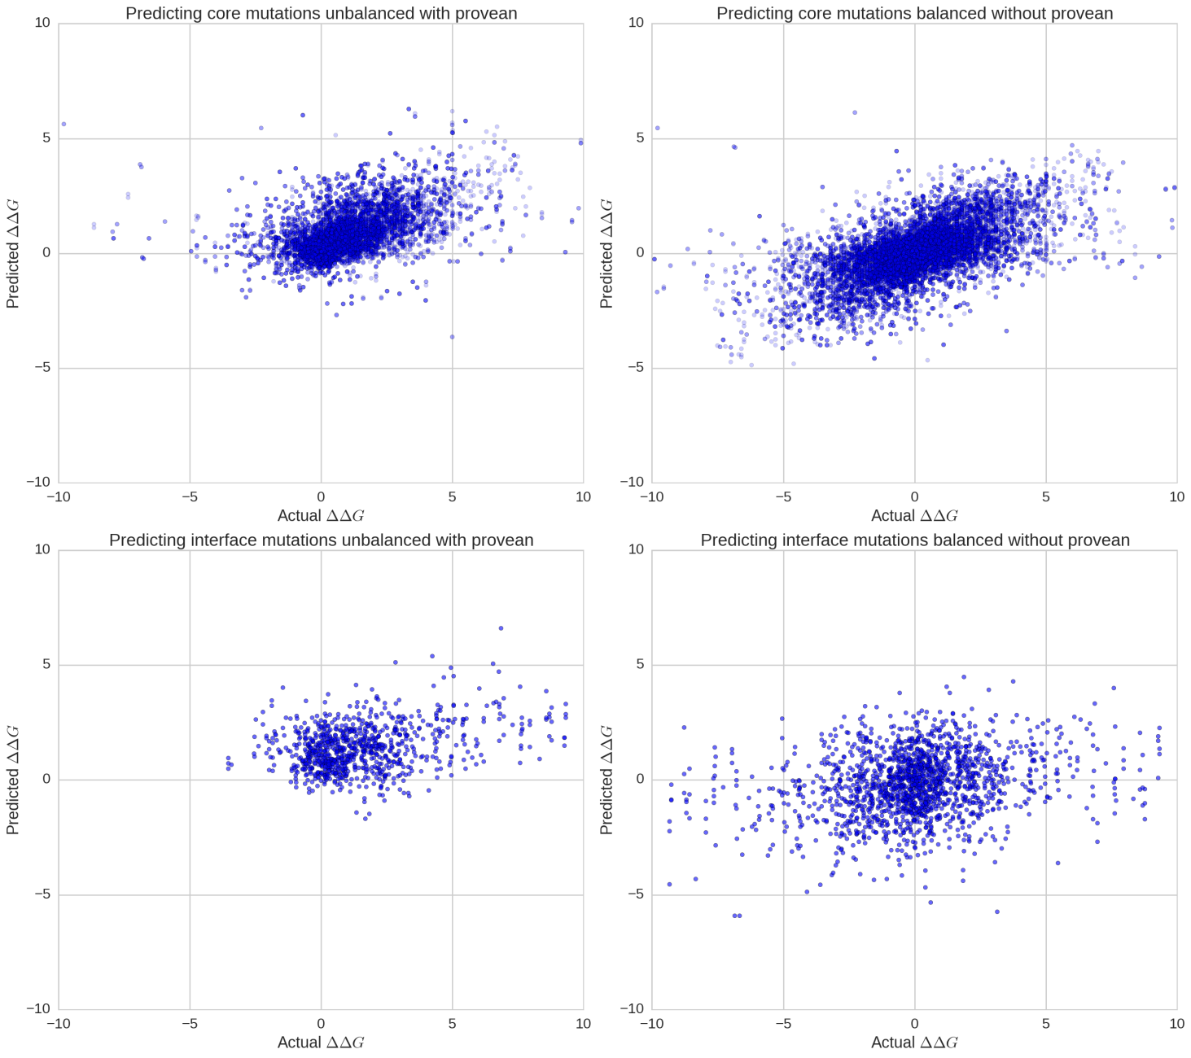
Cross-validation before feature elimination
Provean No reverse mutations
No Provean
Reverse mutations
R² ≈ 0.44
R² ≈ 0.35
Core mutations
R² ≈ 0.37
R² ≈ 0.11
Interface mutations

Slide 71
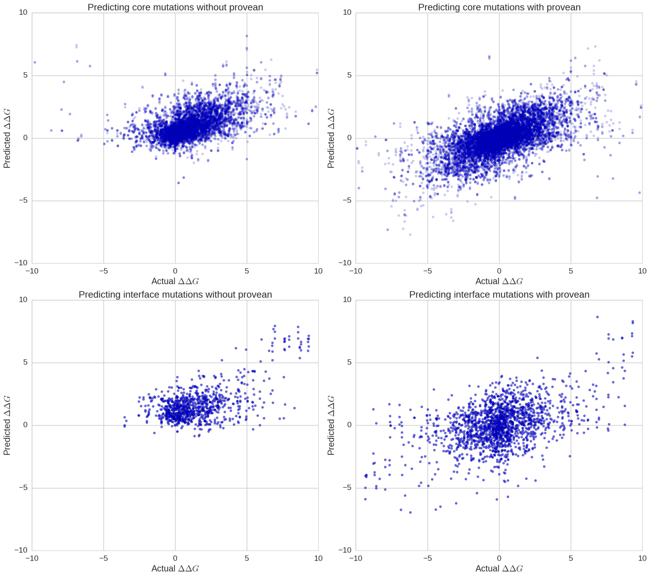
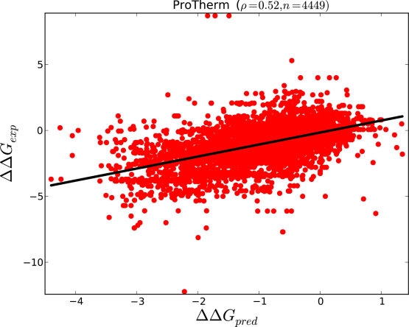
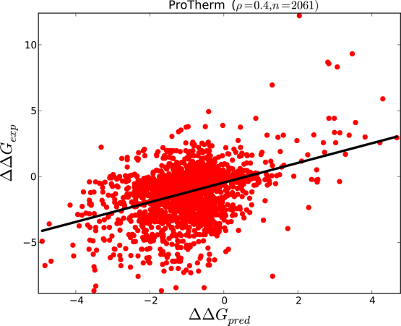
Cross-validation after feature elimination
Provean No reverse mutations
No Provean
Reverse mutations
R² ≈ 0.45
R² ≈ 0.37
Core mutations
R² ≈ 0.58
R² ≈ 0.35
Interface mutations

Slide 72
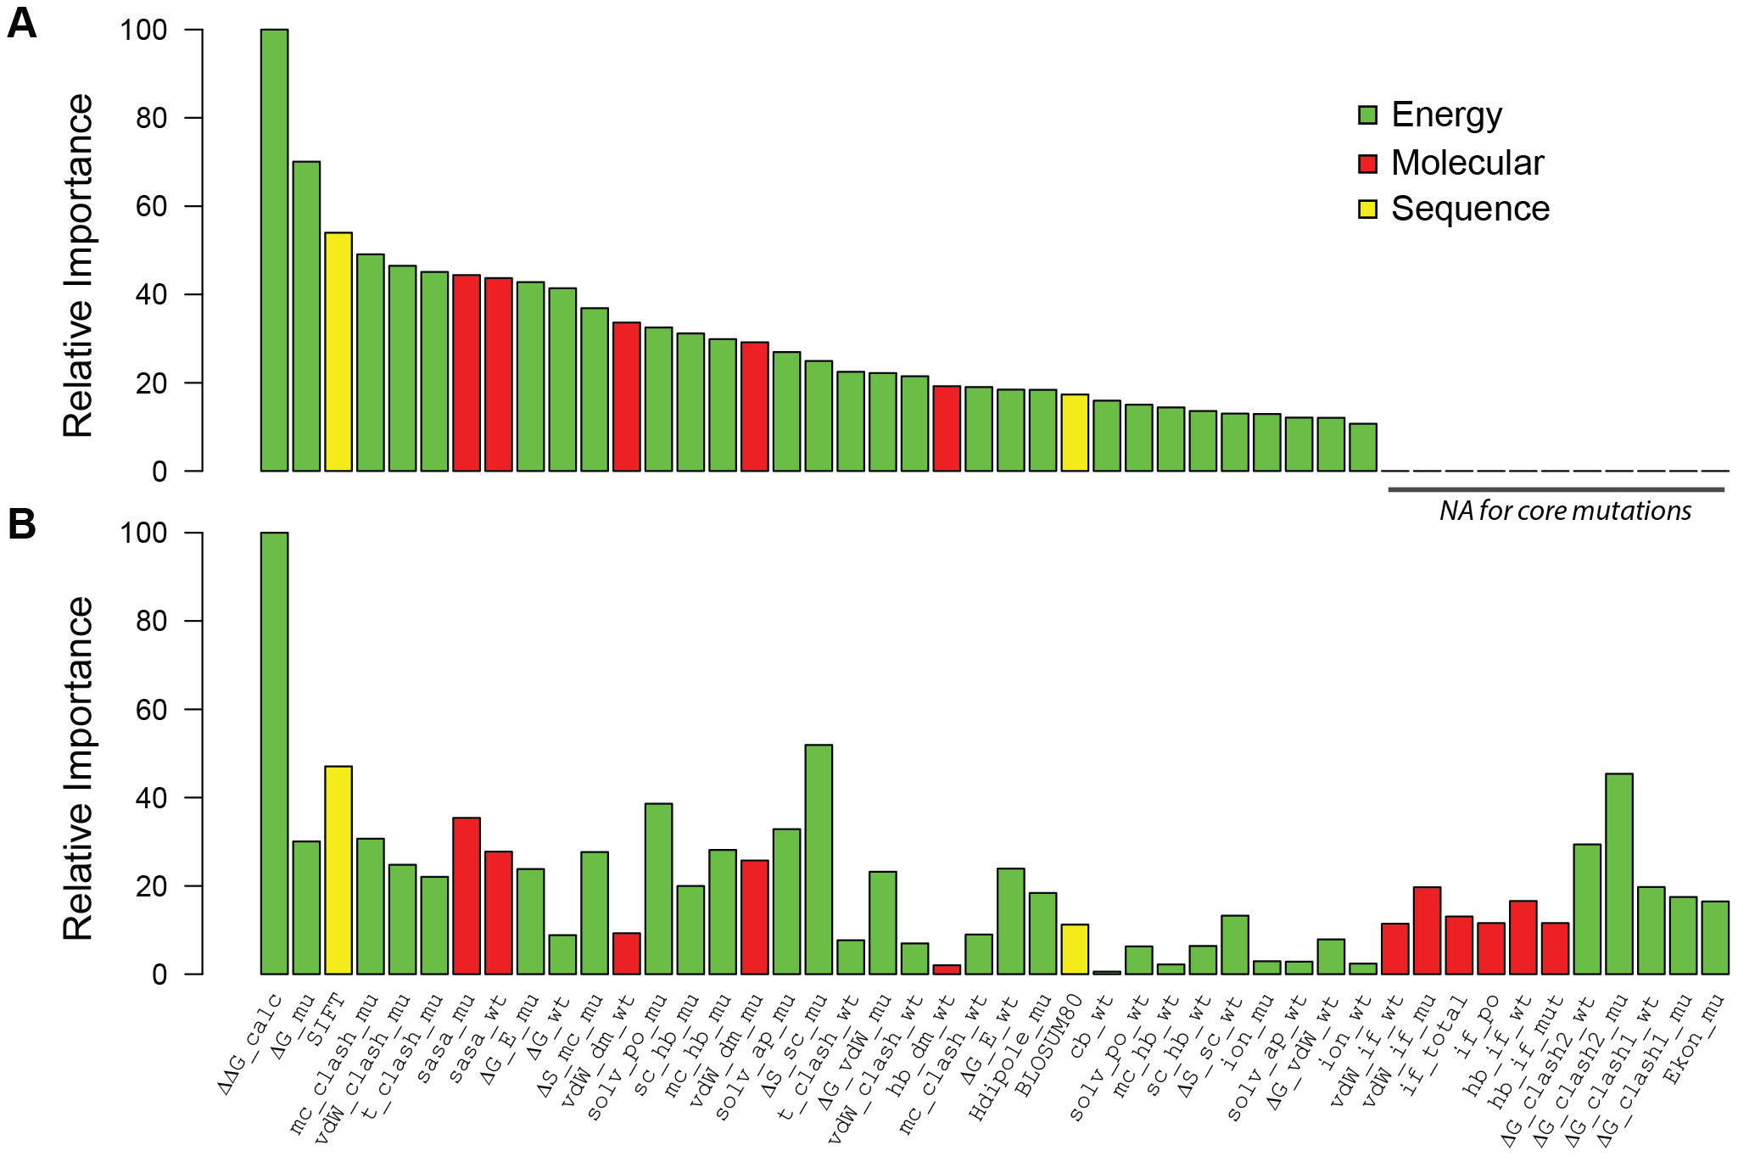
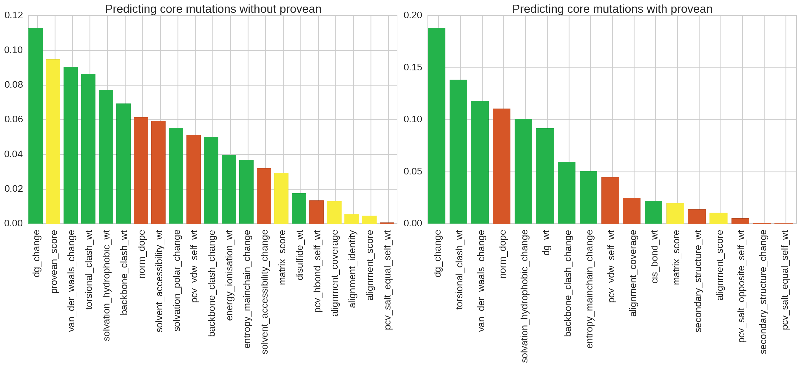
Significant features for core mutations
Provean No reverse mutations
No Provean
Reverse mutations
Relative importance

Slide 73

Significant features for interface mutations
Provean No reverse mutations
No Provean
Reverse mutations
Relative importance

